Slide 1
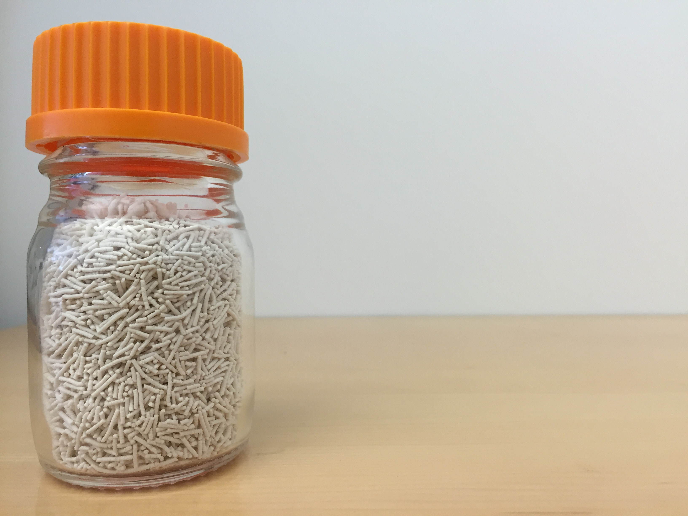

Thomas M. McDonald, Ph.D.
www.mosaicmaterials.com

Slide 2
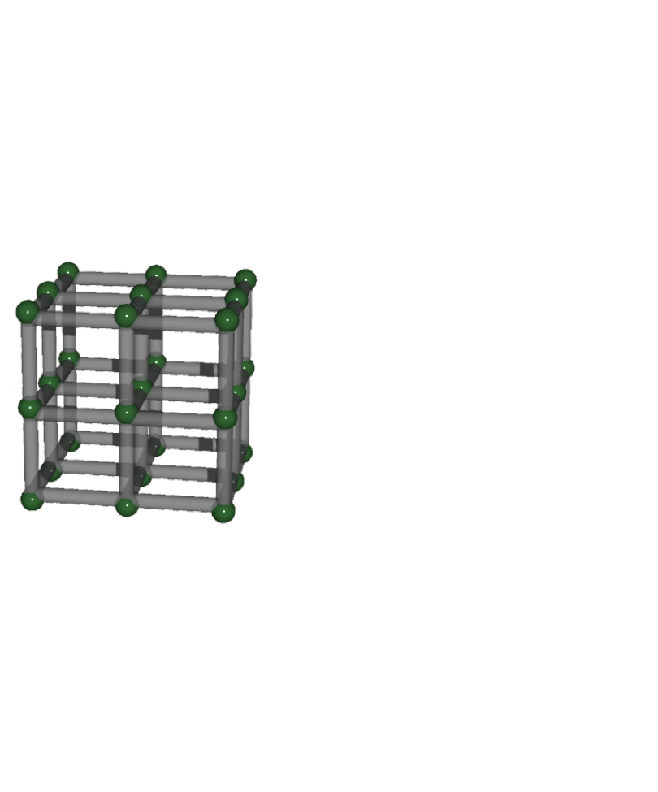

Slide 3
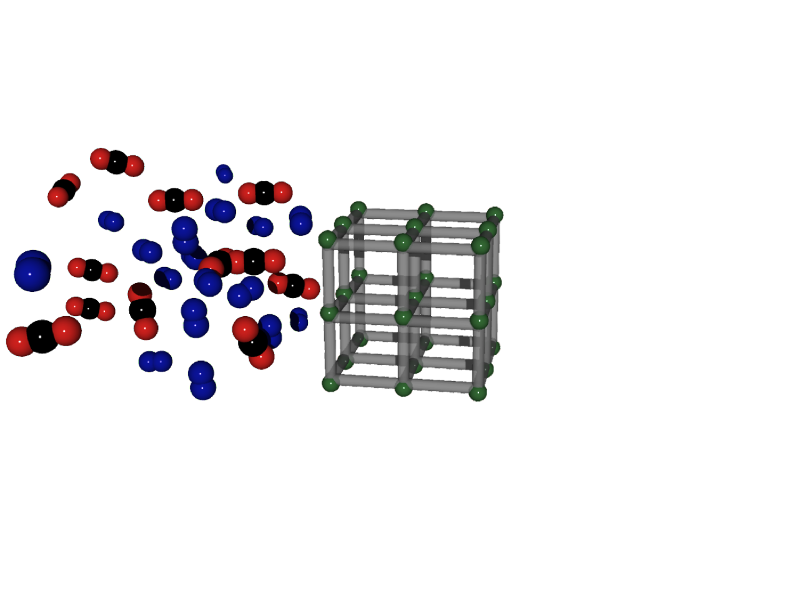

Slide 4
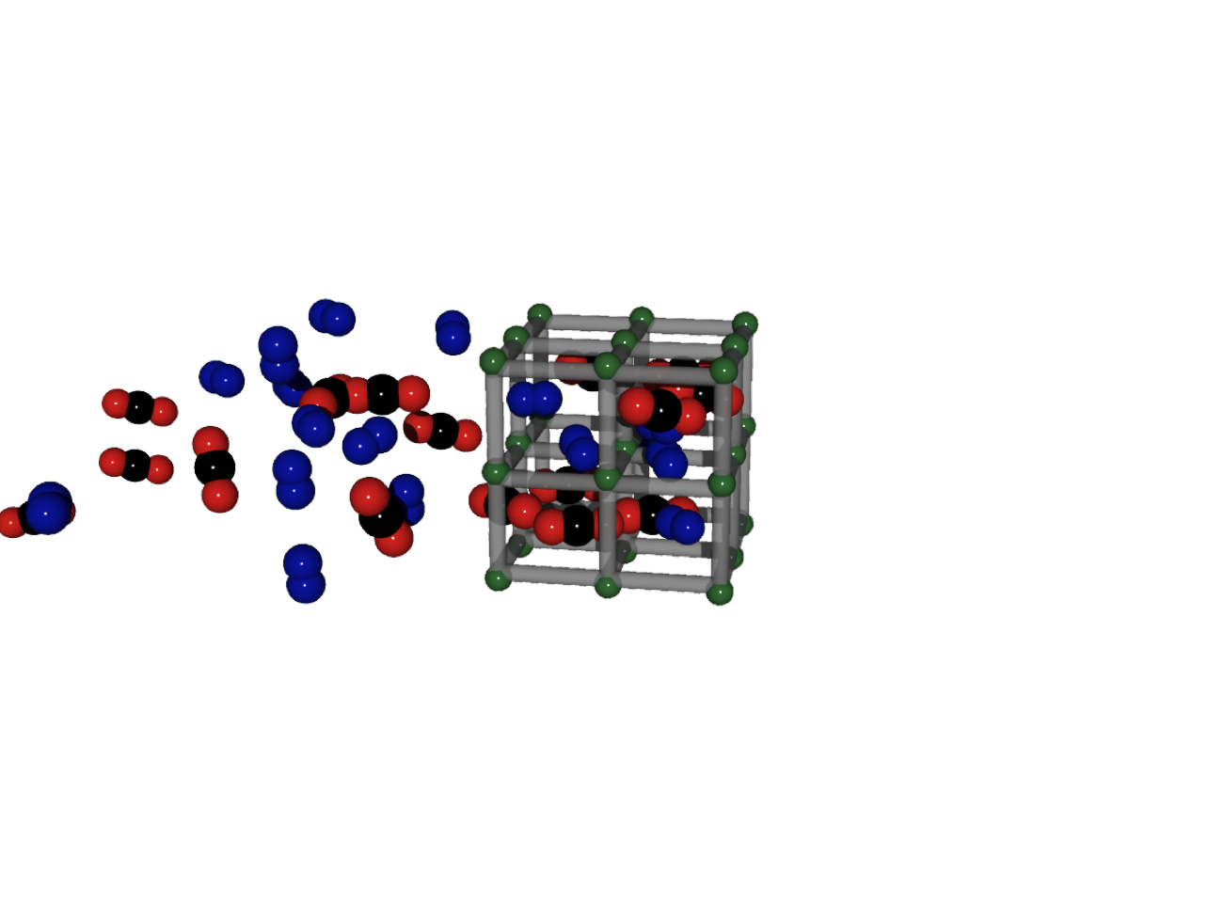

Slide 5
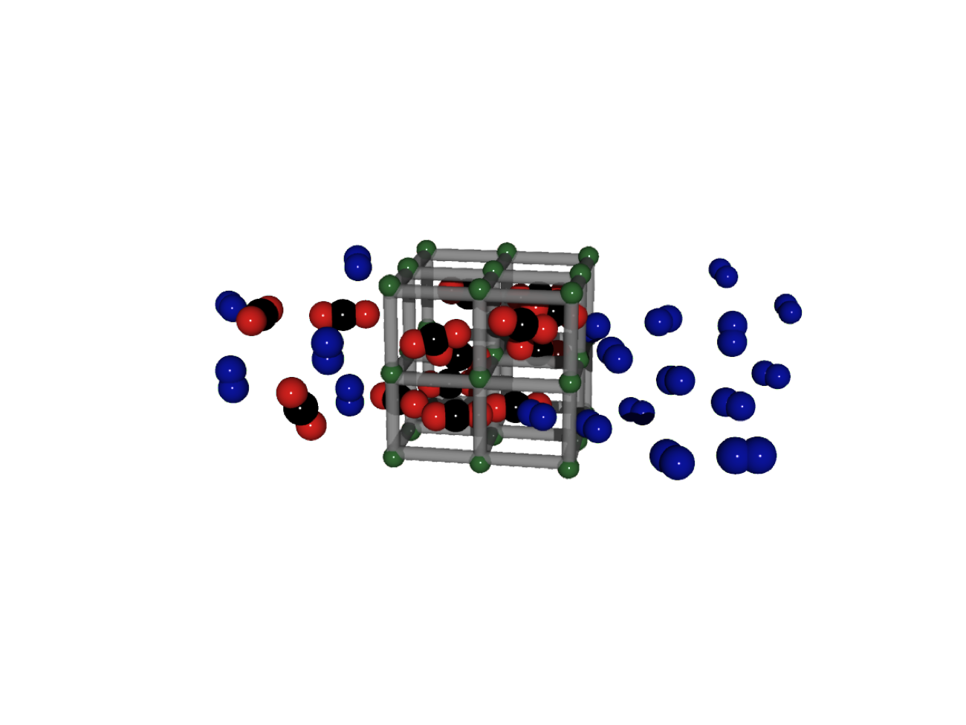

Slide 6
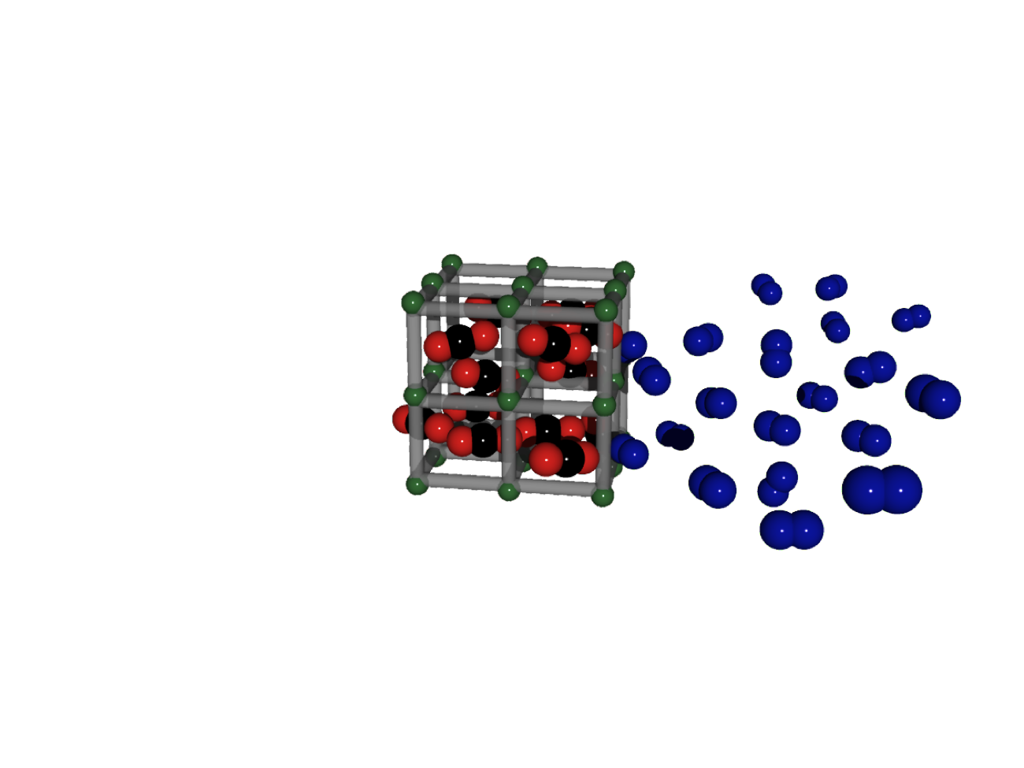

Slide 7
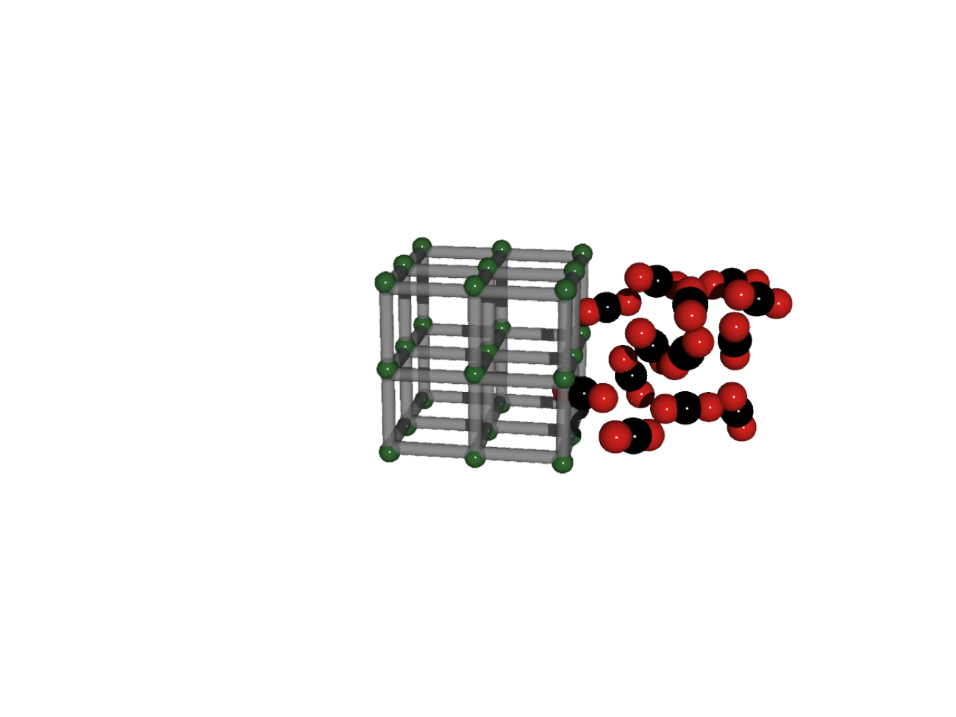

Slide 8
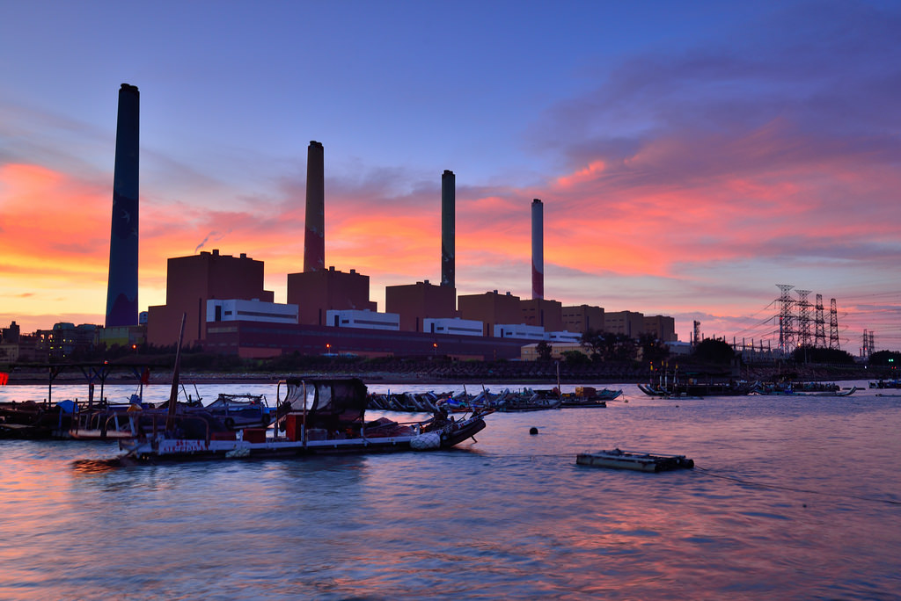
© Vincent Ting

Slide 9
80,000,000,000 pounds of CO₂ every year!
© Vincent Ting

Slide 10
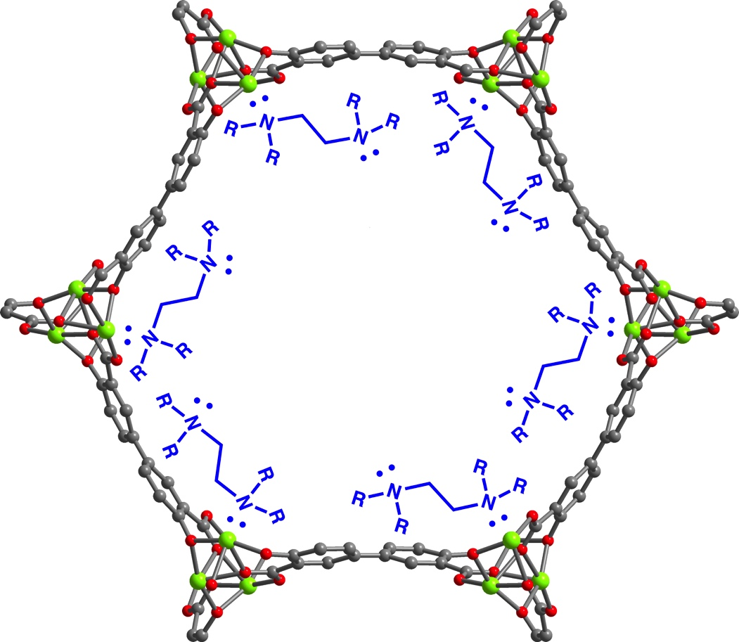
Amines
+
Mosaic Materials

Slide 11
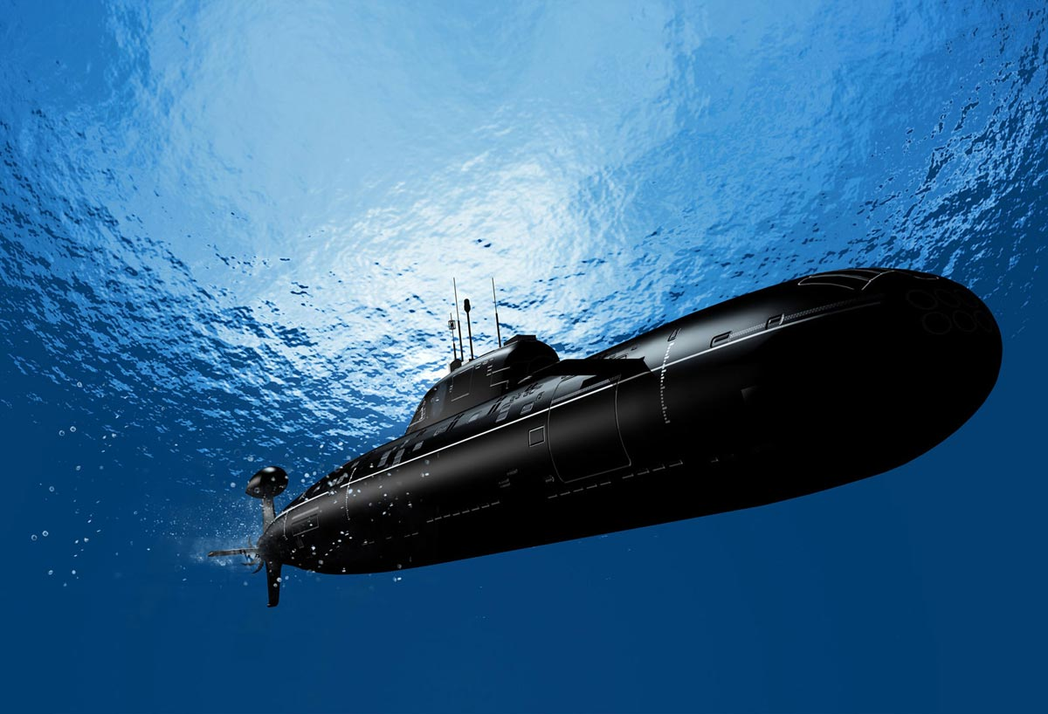

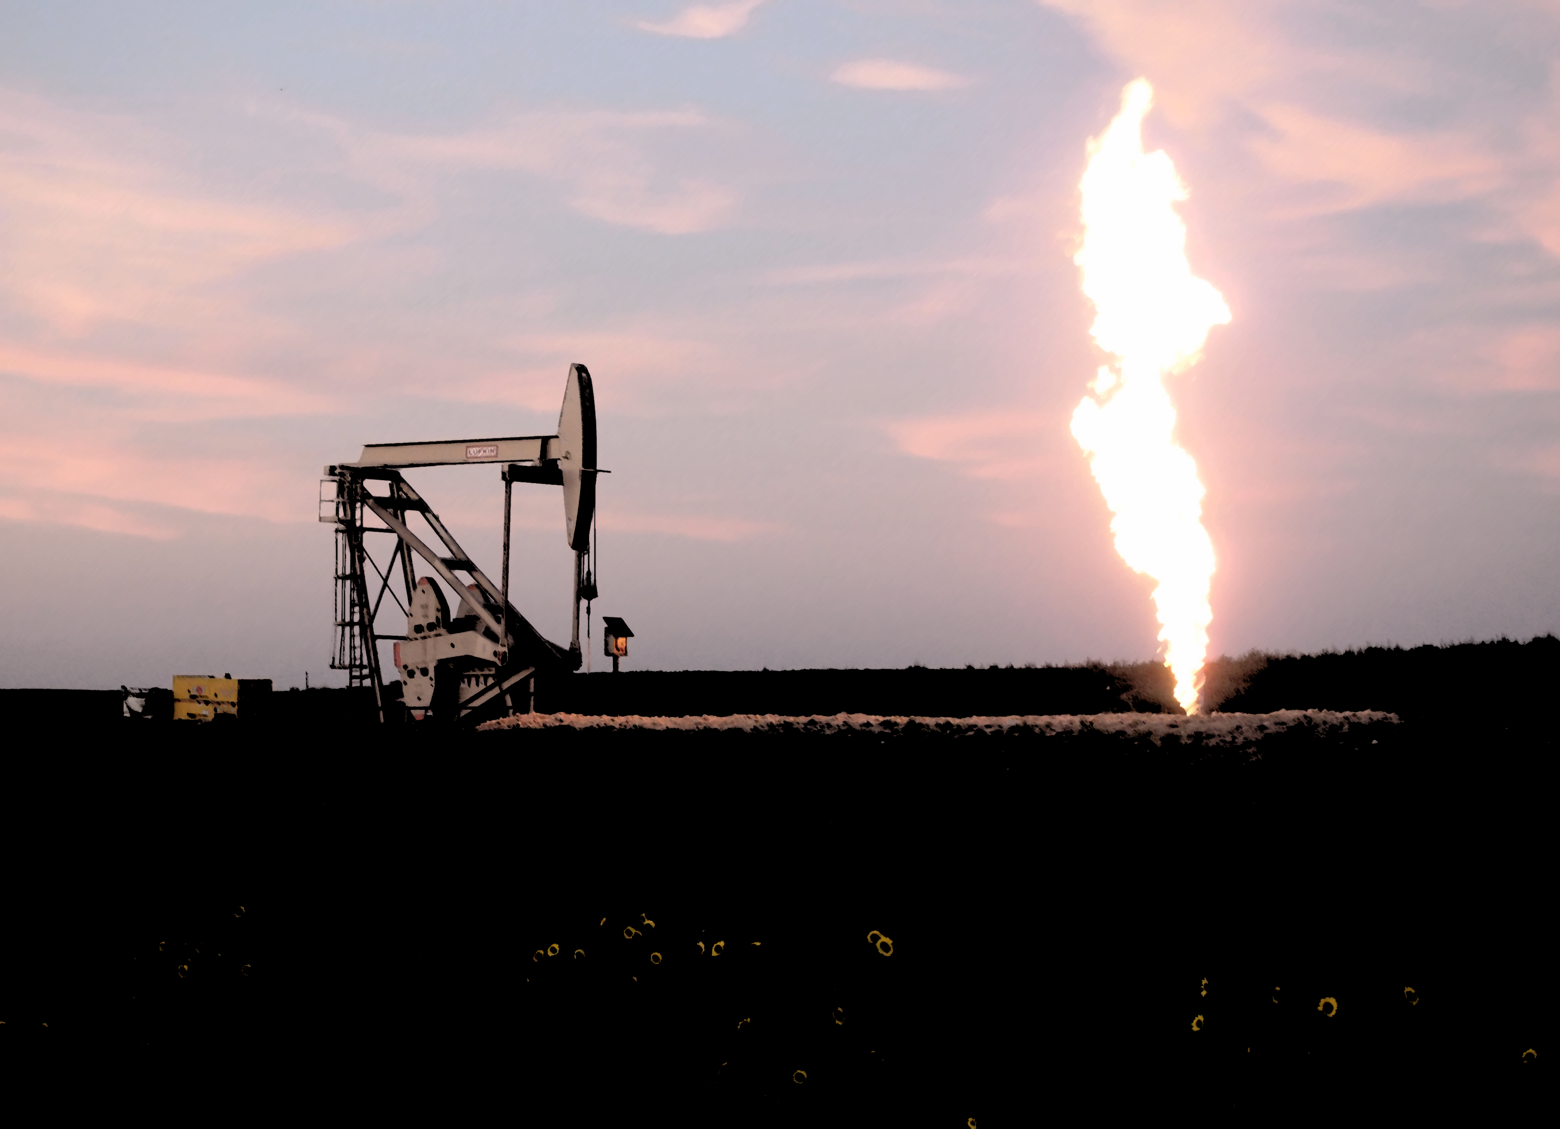
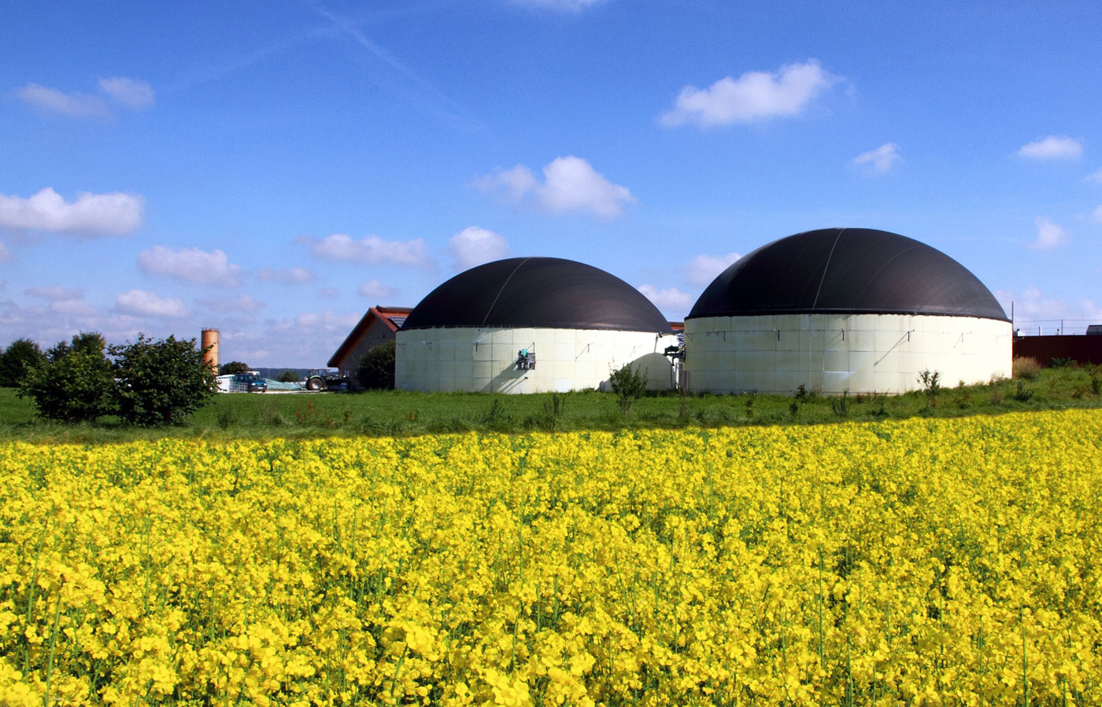


Slide 15
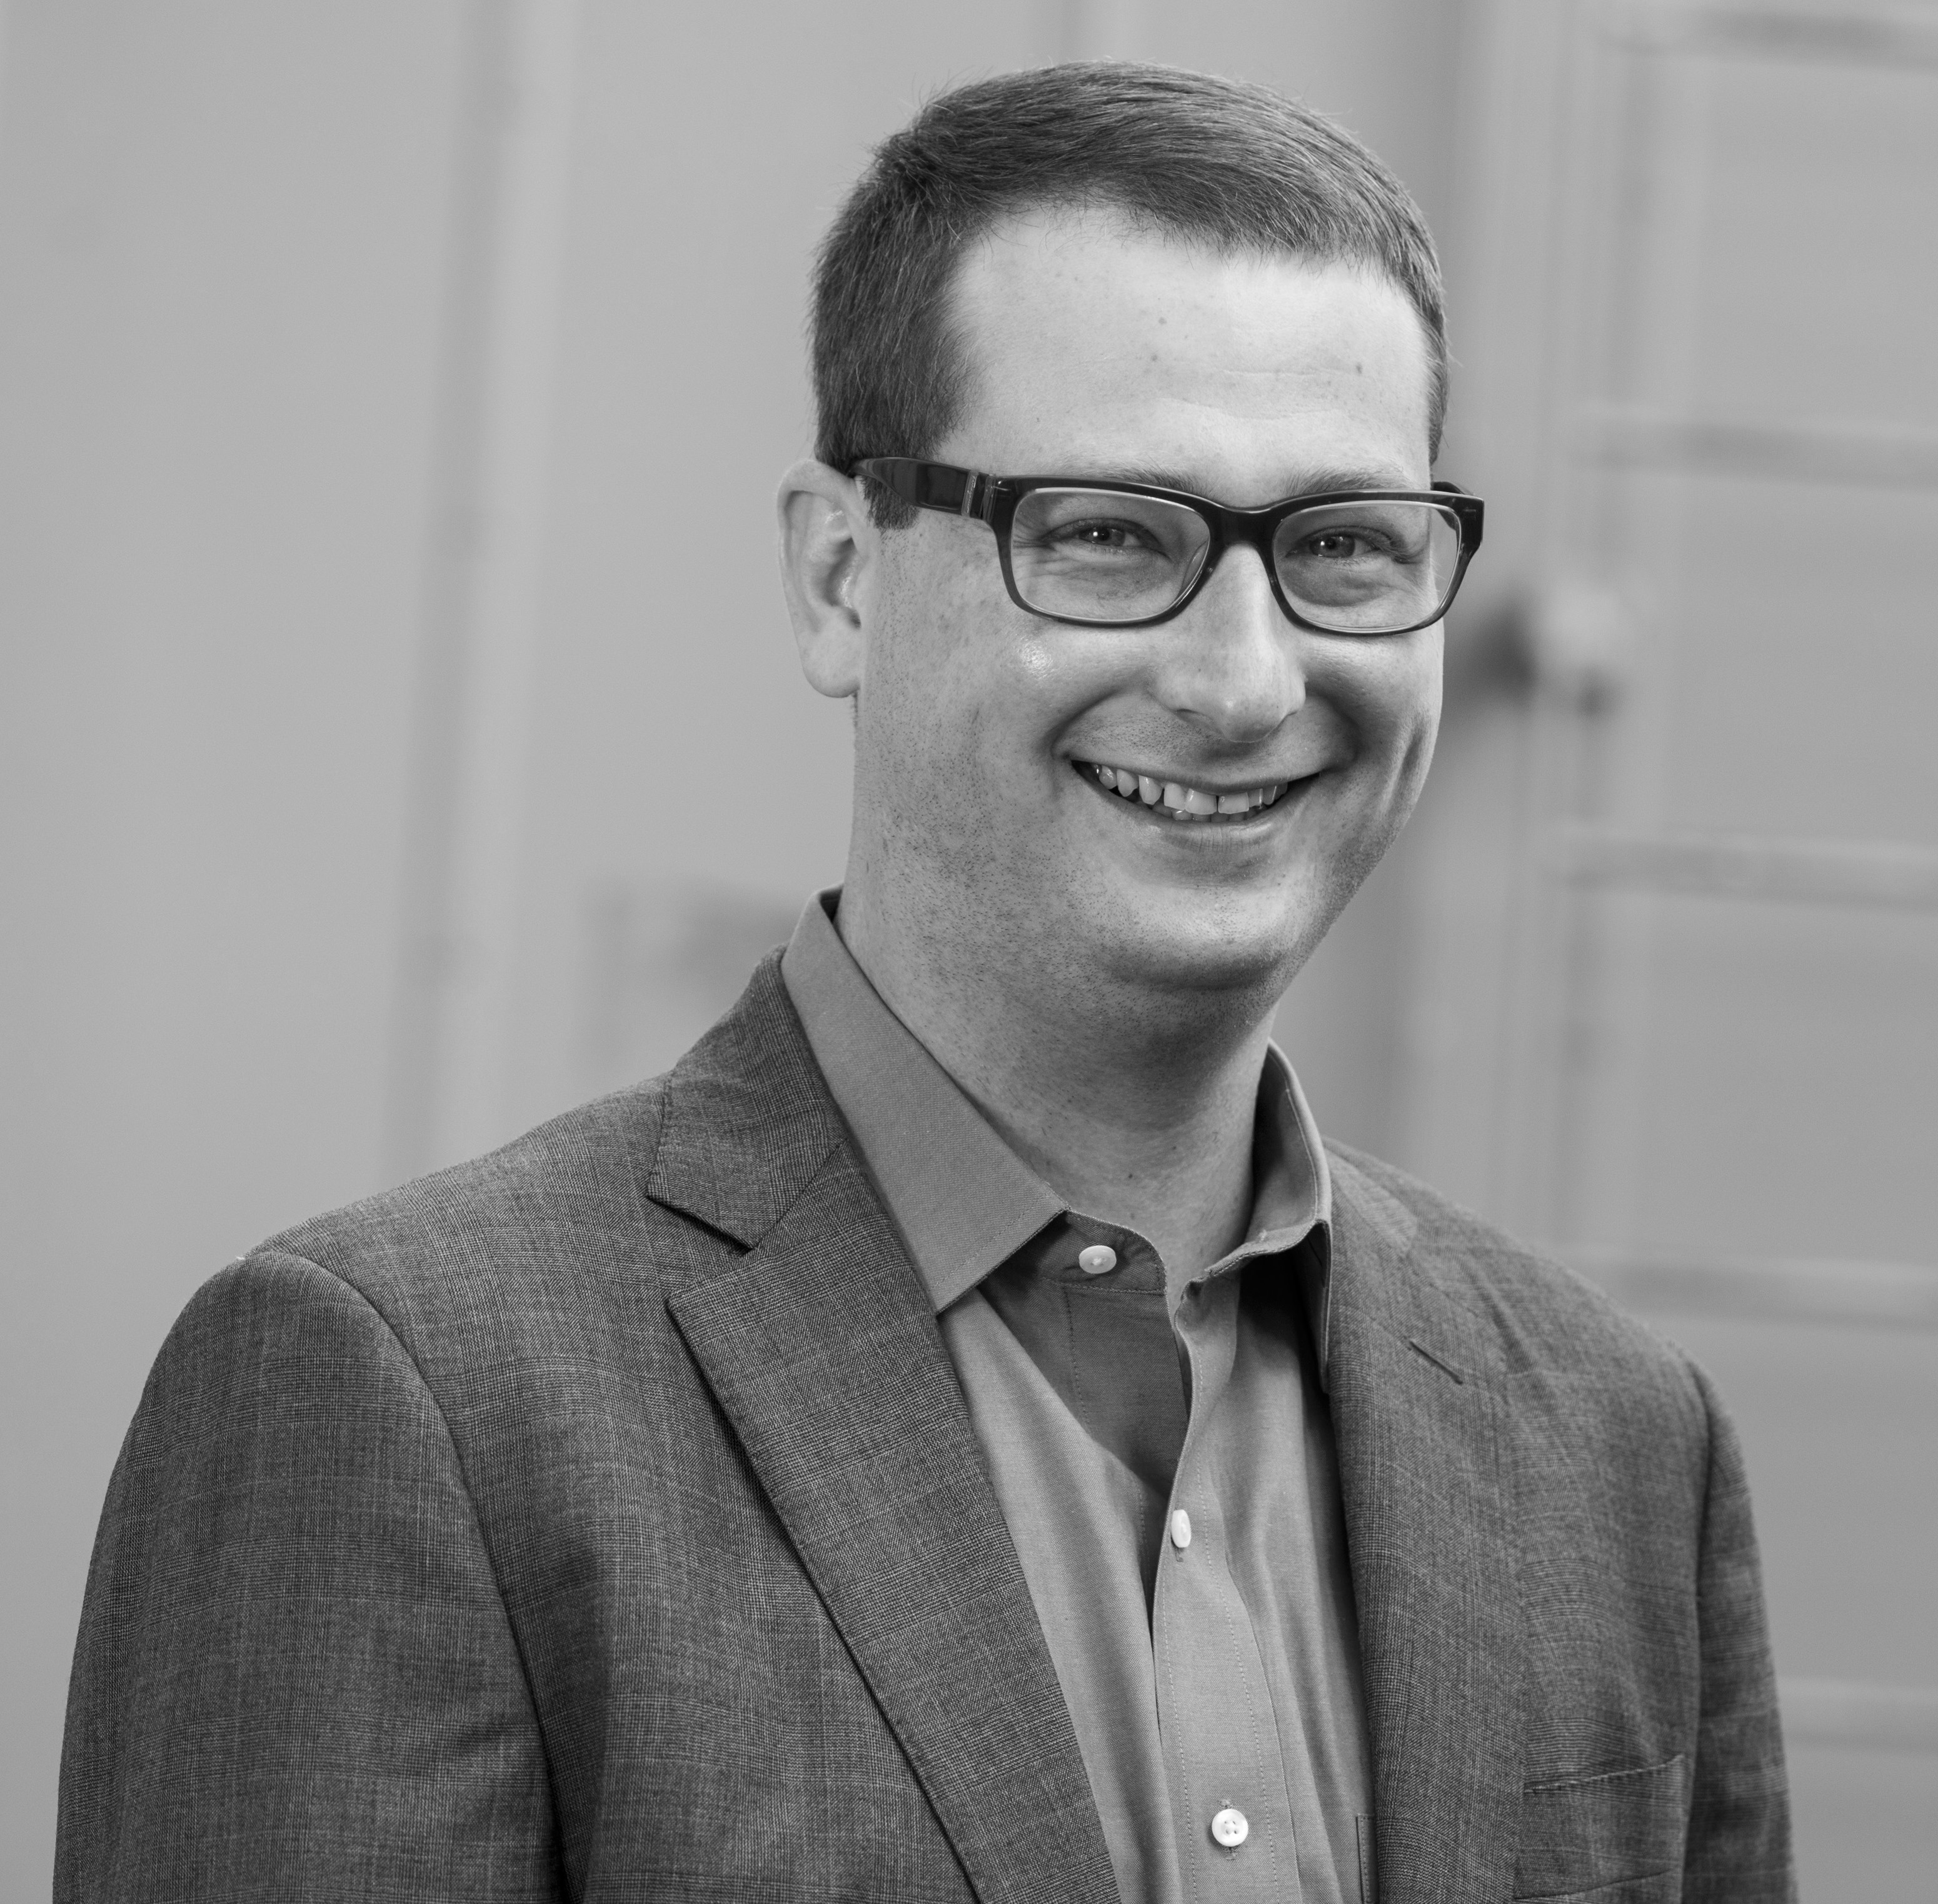
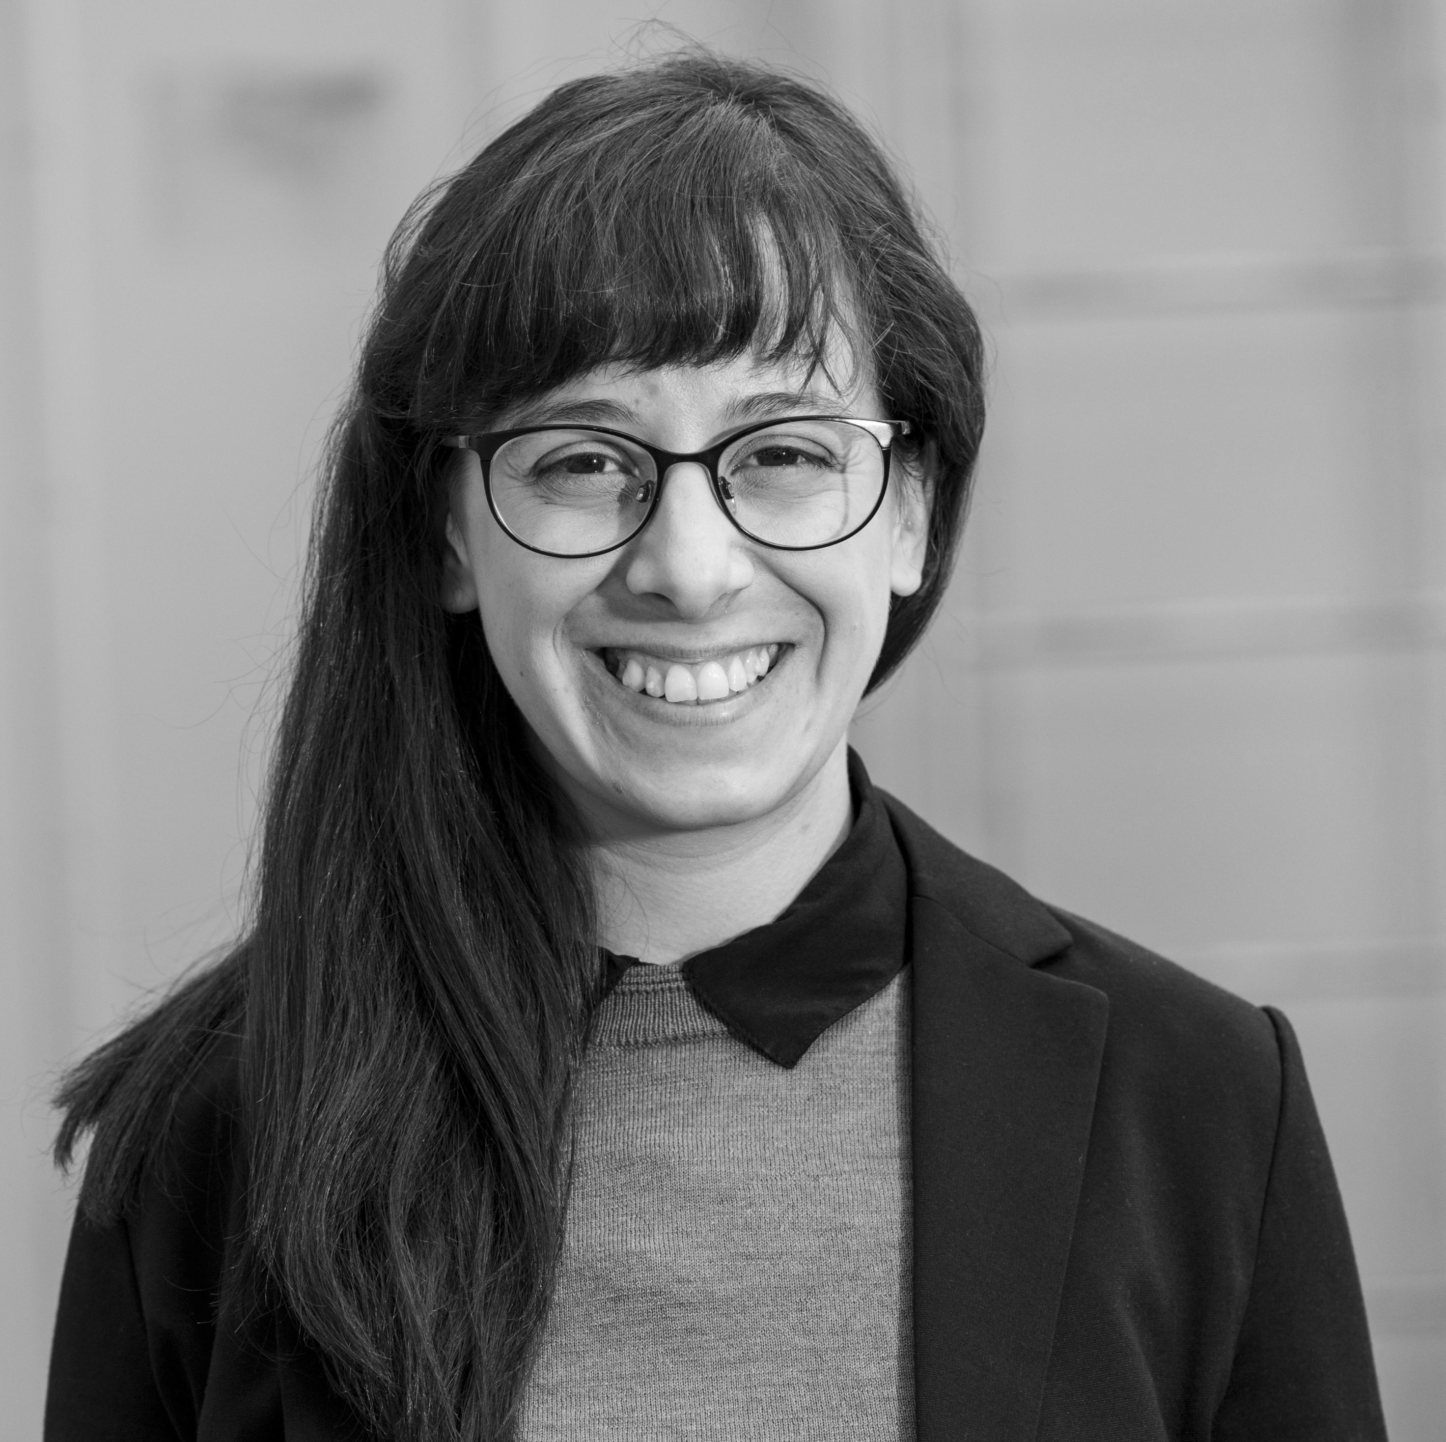
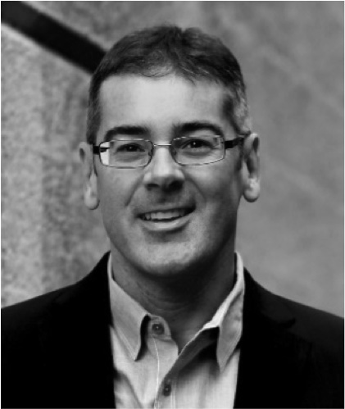
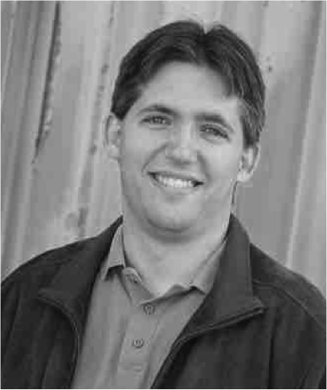
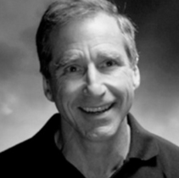
Dr. Tom McDonald
CEO
Dr. Zoey Herm
Senior Scientist
Prof. Jeff Long
Co-founder
Dr. Steven Kaye
Co-founder
Dr. Mike Biddle
Director

Slide 16
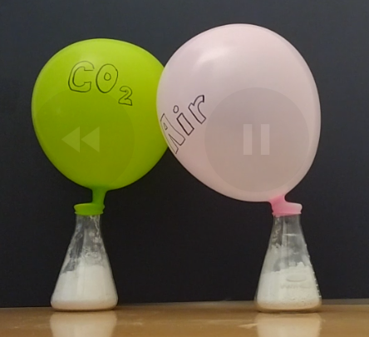

Slide 17



Slide 18

&
Development partners
Advisors
Future investors
Chemists & engineers

